Slide 1
All tests are two way ANOVA with Diagnosis (T=typical; A=Autism Spectrum Disorder) and Theory of Mind as factors
Any main effect found (p<.05) was tested using Bonferroni post hoc test and confirmed

Slide 2
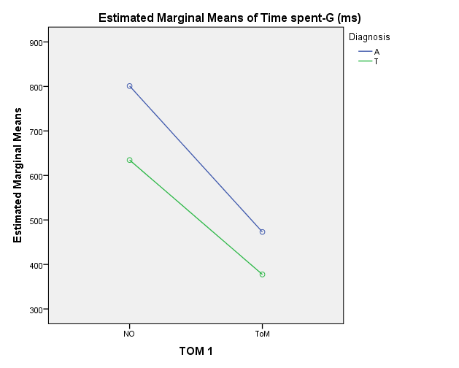
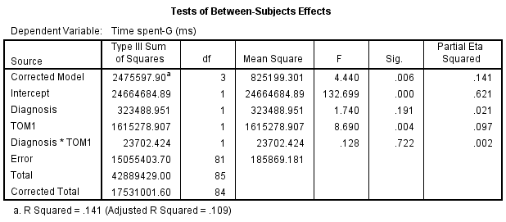
Time spent “Gaze” on Ball
Interaction between Diagnosis and Theory of Mind
Significant effect of ToM (p<.0001), but not of diagnosis

Slide 3
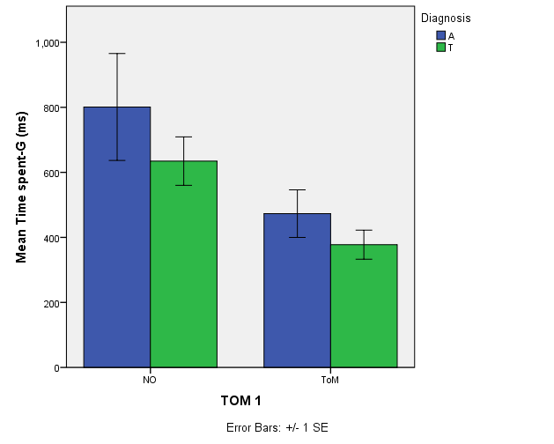
Time spent “Gaze” on Ball
Interaction between Diagnosis and Theory of Mind
Significant effect of ToM (p=.004), but not of diagnosis

Slide 4
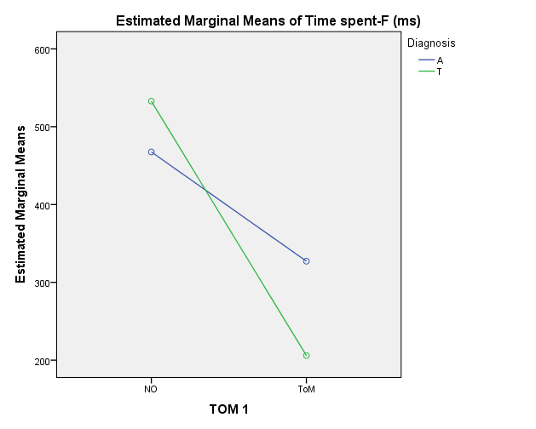
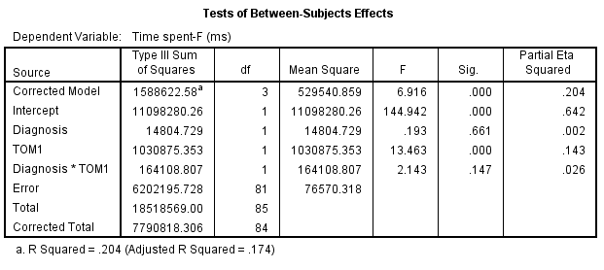
Time spent “Fixed” on Ball
Interaction between Diagnosis and Theory of Mind
Significant effect of ToM (p<.0001), but not of diagnosis

Slide 5
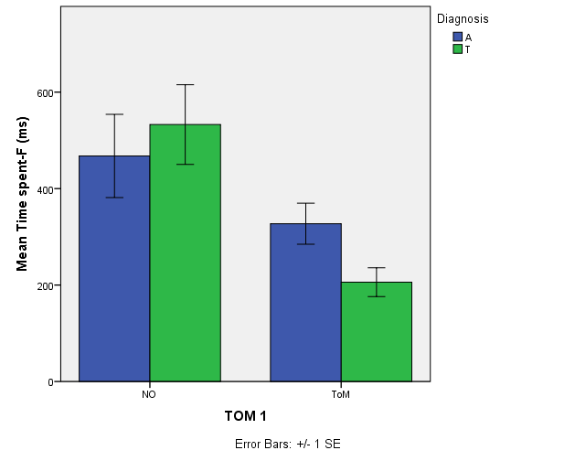
Time spent “Fixed” on Ball
Interaction between Diagnosis and Theory of Mind
Significant effect of ToM (p<.0001), but not of diagnosis

Slide 6
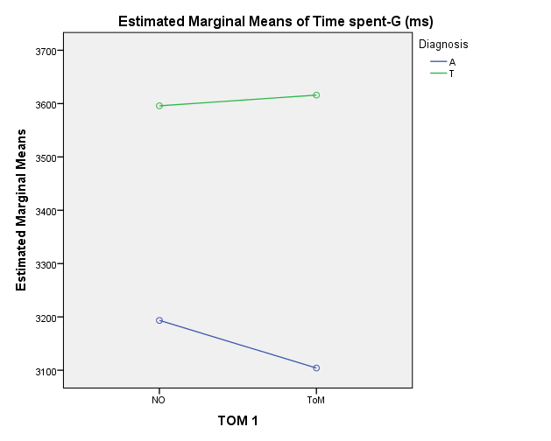
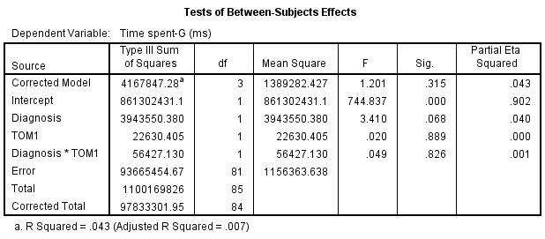
Time spent “Gaze” on Eyes
Interaction between Diagnosis and Theory of Mind
No significant differences based on ToM, but trend based on diagnosis (p=.068)

Slide 7
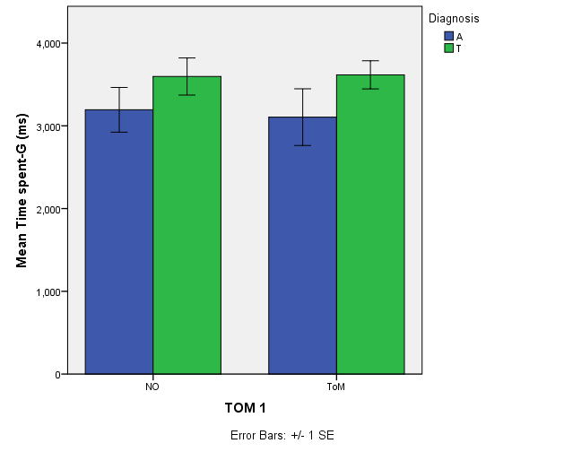
Time spent “Gaze” on Eyes
Interaction between Diagnosis and Theory of Mind
No significant differences based on ToM, but trend based on diagnosis (p=.068)

Slide 8
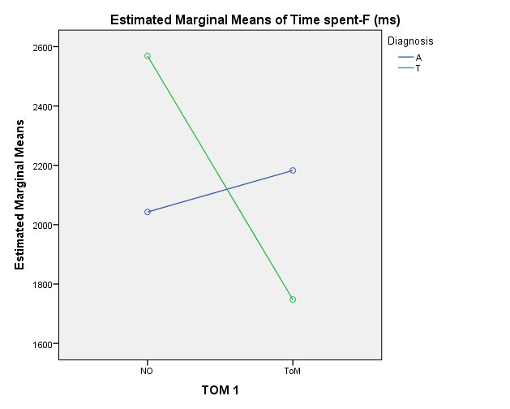
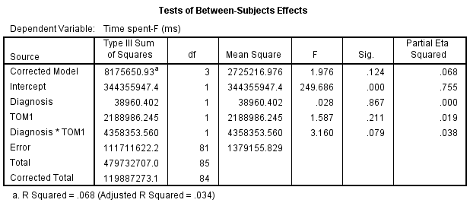
Time spent “Fixed” on Eyes
Interaction between Diagnosis and Theory of Mind
No significant differences based on diagnosis or ToM, but trend based interaction of these variables (p=.079)

Slide 9
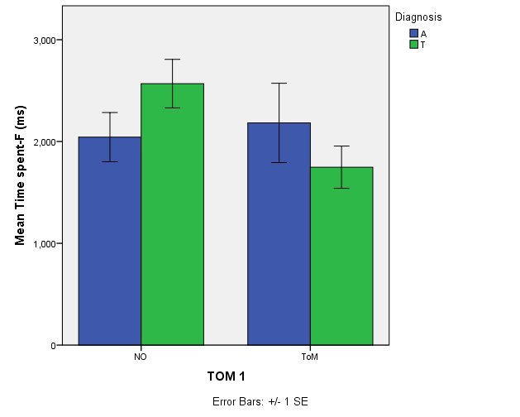
Time spent “Fixed” on Eyes
Interaction between Diagnosis and Theory of Mind

Slide 10
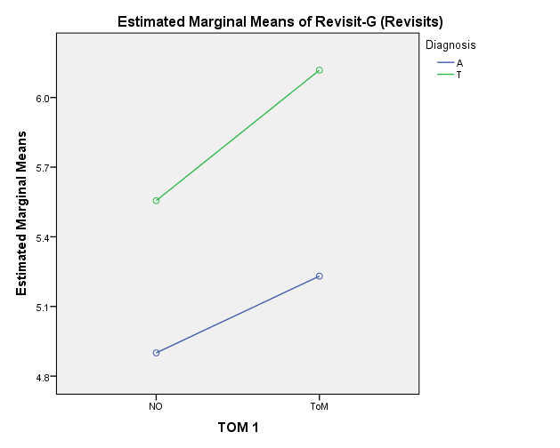
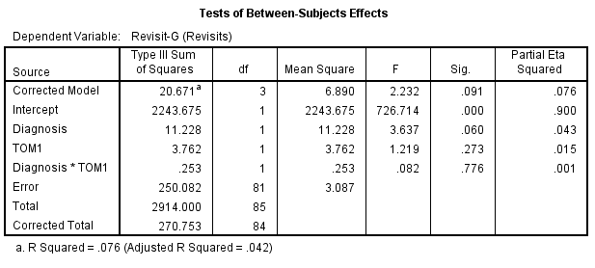
Number of “Revisits to Eyes”
Interaction between Diagnosis and Theory of Mind
No significant differences based on ToM, but trend based diagnosis (p=.06)

Slide 11
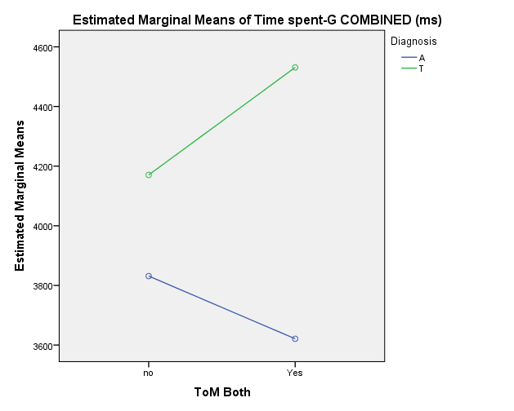
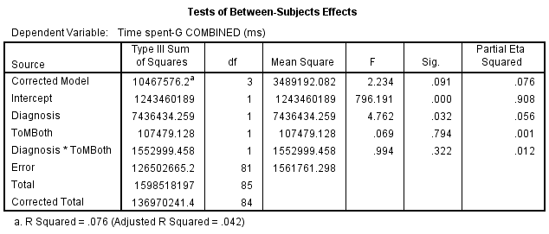
Amount time “Gaze” on Eyes COMBINED during both ToM tests
Interaction between Diagnosis and Theory of Mind
*ToM Both means child displayed ToM on both tests
Significant differences based on diagnosis (p=.032) but not of ToM

Slide 12
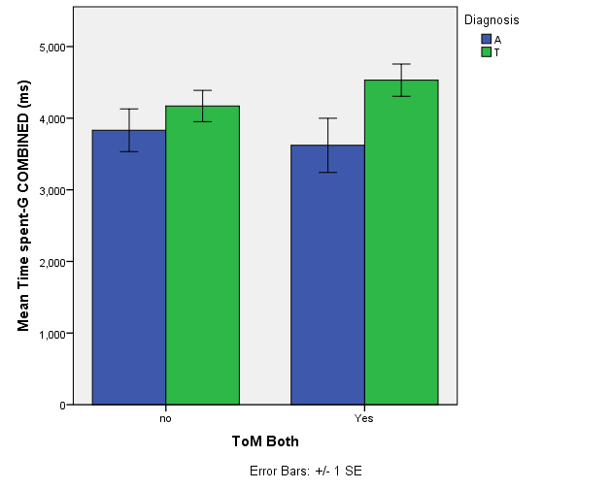
Amount time “Gaze” on eyes COMBINED during both ToM tests
Interaction between Diagnosis and Theory of Mind
*ToM Both means child displayed ToM on both tests
Significant differences based on diagnosis (p=.032) but not of ToM

Slide 13
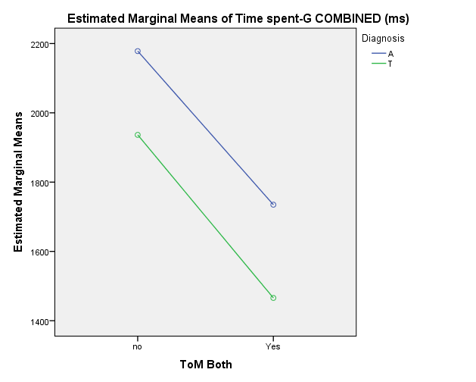
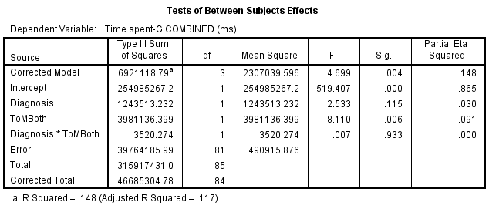
Amount time “Gaze” on Ball COMBINED during both ToM tests
Interaction between Diagnosis and Theory of Mind
*ToM Both means child displayed ToM on both tests
Significant differences based on ToM(p=.006) but not of Diagnosis

Slide 14
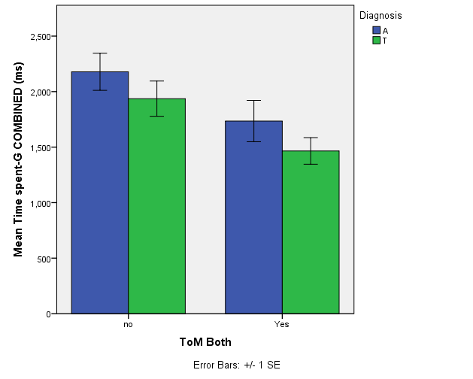
Amount time “Gaze” on Ball COMBINED during both ToM tests
Interaction between Diagnosis and Theory of Mind
*ToM Both means child displayed ToM on both tests
Significant differences based on ToM(p=.006) but not of Diagnosis

Slide 15
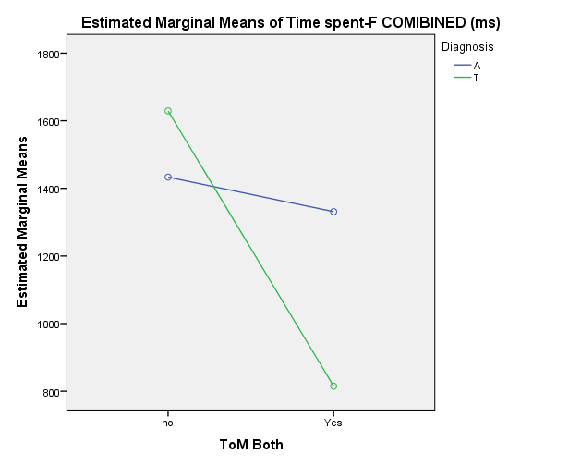
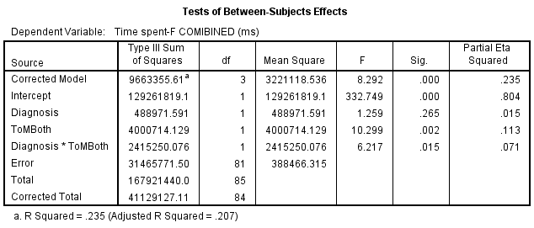
Amount time “Fixed” on Ball COMBINED during both ToM tests
Interaction between Diagnosis and Theory of Mind
*ToM Both means child displayed ToM on both tests
Significant differences based on ToM(p=.002) but not of Diagnosis
Also an significant interaction effect between two factors (p=.015)

Slide 16
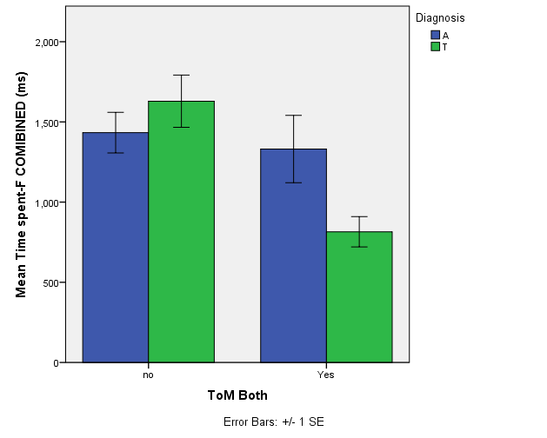
Amount time “Fixed” on Ball COMBINED during both ToM tests
Interaction between Diagnosis and Theory of Mind
*ToM Both means child displayed ToM on both tests
Significant differences based on ToM(p=.002) but not of Diagnosis
Also an significant interaction effect between two factors (p=.015)

